Slide 1
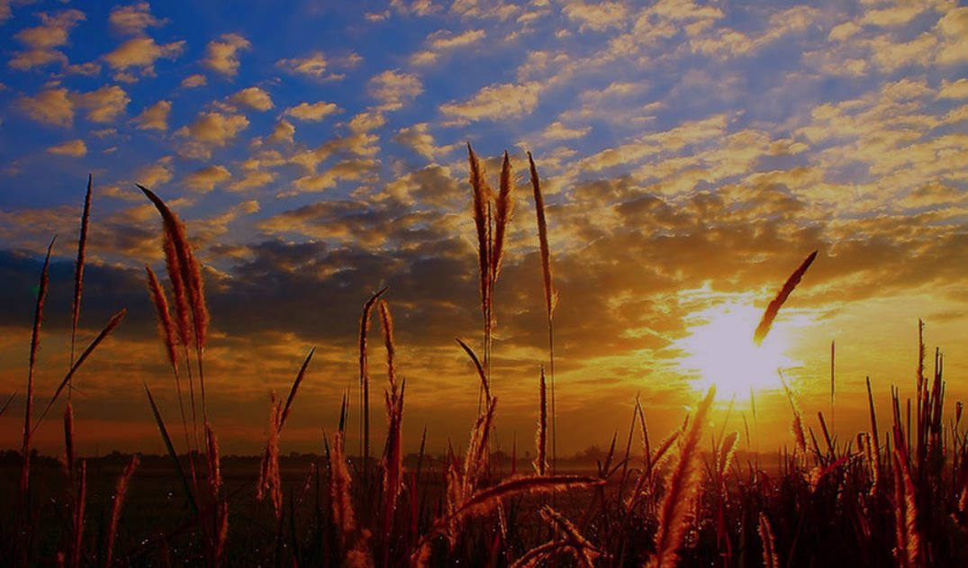
CROP WEATHER CALENDAR AND PHENOLOGY PREDICTION USING HEAT INDICES
By:
Krupali Bhayani (202419003)
Koneenika Mallick (202419008)
Nidhi Chaudhary (202419004)
Under the guidance of :
Dr. S.B. Yadav
Assistant Professor (Ag.Met.)
BACA, AAU, Anand

Slide 2
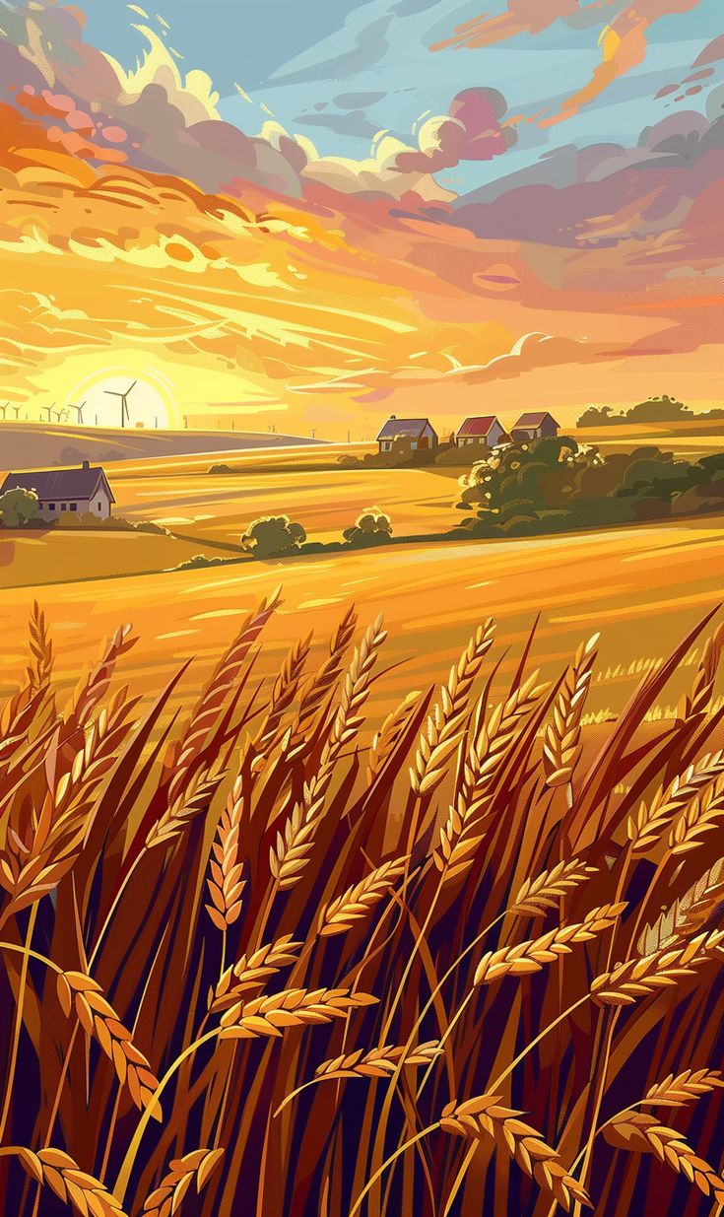
INTRODUCTION
CROP WEATHER CALENDAR
A Crop Weather Calendar (CWC) is a pictorial representation of the entire life cycle of a crop, from sowing to maturity, showing the duration of key phenological stages along with their optimum climatic requirements and the actual or normal weather conditions of a location. It provides vital information on crop growth stages, water needs, and weather conditions favorable for pests and diseases, thereby serving as a guide for crop planning, irrigation scheduling, and plant protection. In short, it is a practical tool that links crop development with weather to help farmers, planners, and policymakers optimize agricultural practices and ensure stable food production.

Slide 3
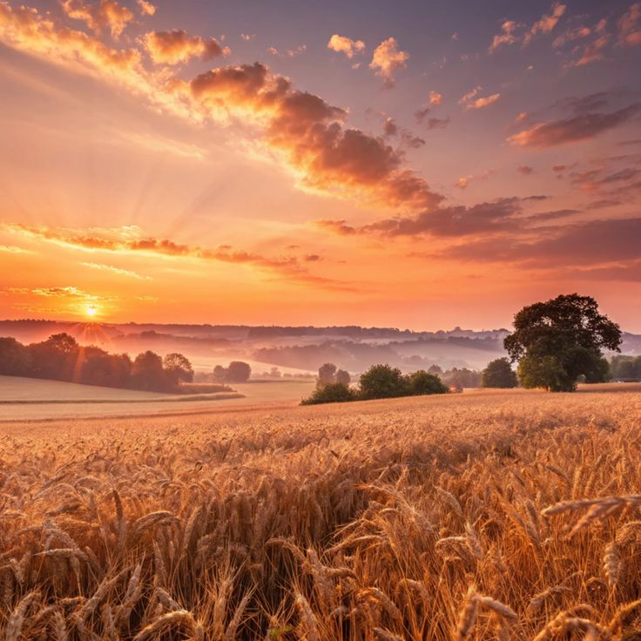
MAJOR INPUTS
A) Upper Portion – Meteorological Data
The top part of a crop weather calendar contains the average weather information for each month and standard meteorological week of the crop’s growing season. It includes parameters like maximum and minimum temperature, rainfall, number of rainy days, relative humidity, and sunshine hours.
(B) Middle Portion – Crop Life Cycle and Growth Phases
The middle section shows the life history of the crop, covering stages such as sowing, germination, vegetative growth, flowering, grain filling, and maturity. This part also highlights the favorable weather conditions required for optimal growth and high yield at different stages.

Slide 4
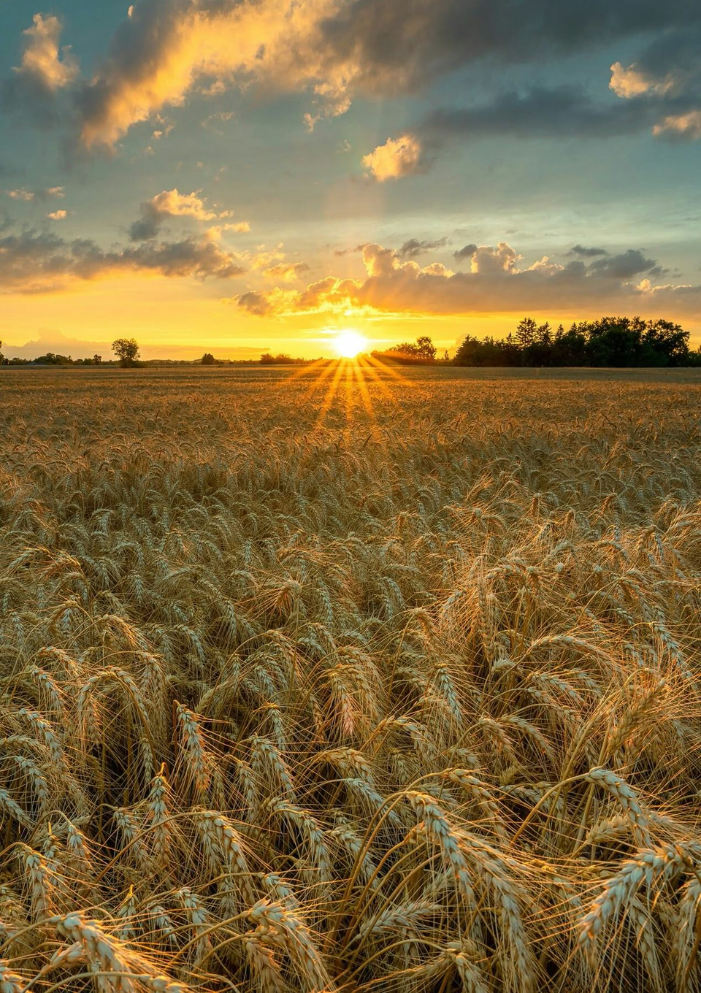
MAJOR INPUTS
C) Bottom Portion – Pests, Diseases, and Warnings
The bottom section indicates meteorological conditions that favor pest and disease outbreaks and shows the susceptible crop stages. If weather conditions align with pest/disease risk and inoculum is present, outbreaks may occur. This part helps agrometeorologists issue weather-based advisories for plant protection measures, ensuring timely control and reducing yield losses.

Slide 5
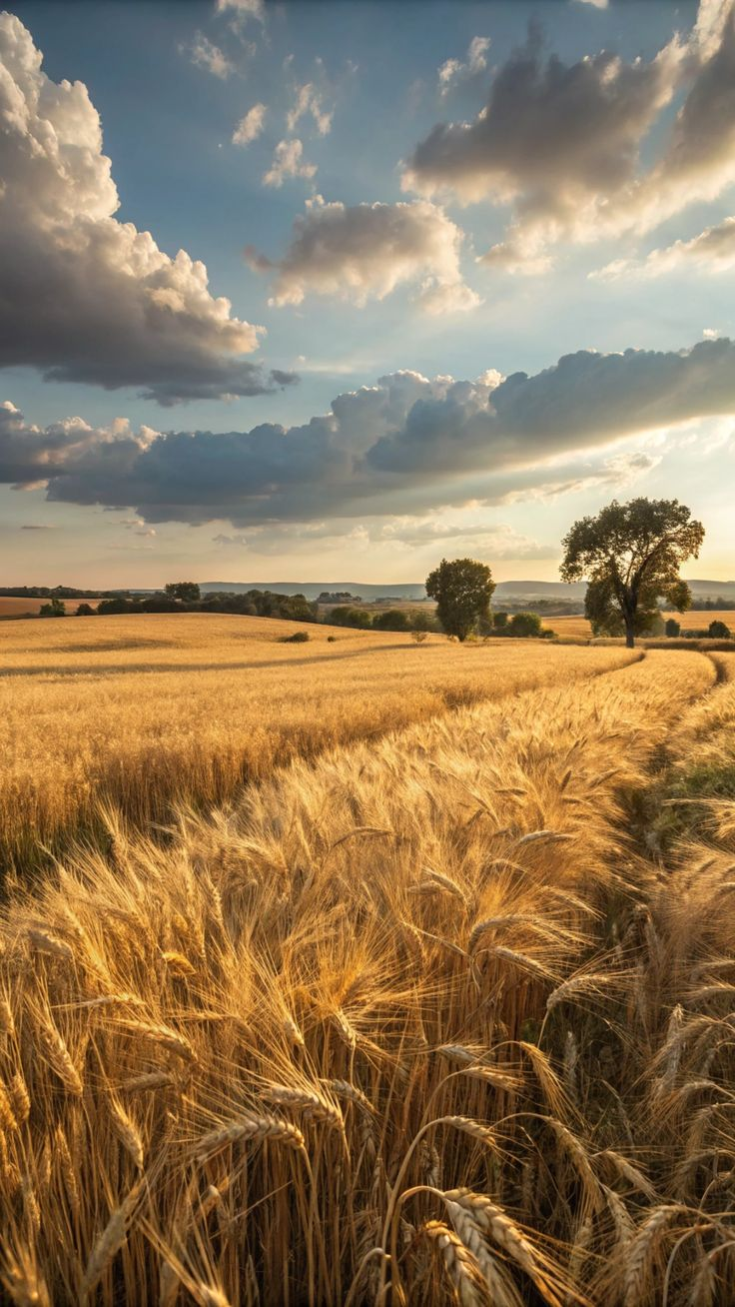
Applications of Crop Weather Calendars
Provides stage-wise timeline for crop planning and scheduling.
Indicates critical growth stages for timely irrigation.
Guides proper timing of fertilizer and nutrient application.
Highlights weather conditions favorable for pests and diseases.
Supports varietal adaptation and regional crop suitability.
Limitations of Crop Weather Calendars
Based on long-term averages, not real-time weather.
Effective only for the specific region where developed.
Often ignore solar radiation, soil moisture, or humidity.
Require long-term reliable weather records for accuracy.
Generalize across varieties without specific adjustments.
Need frequent updates and validation for reliability.

Slide 6
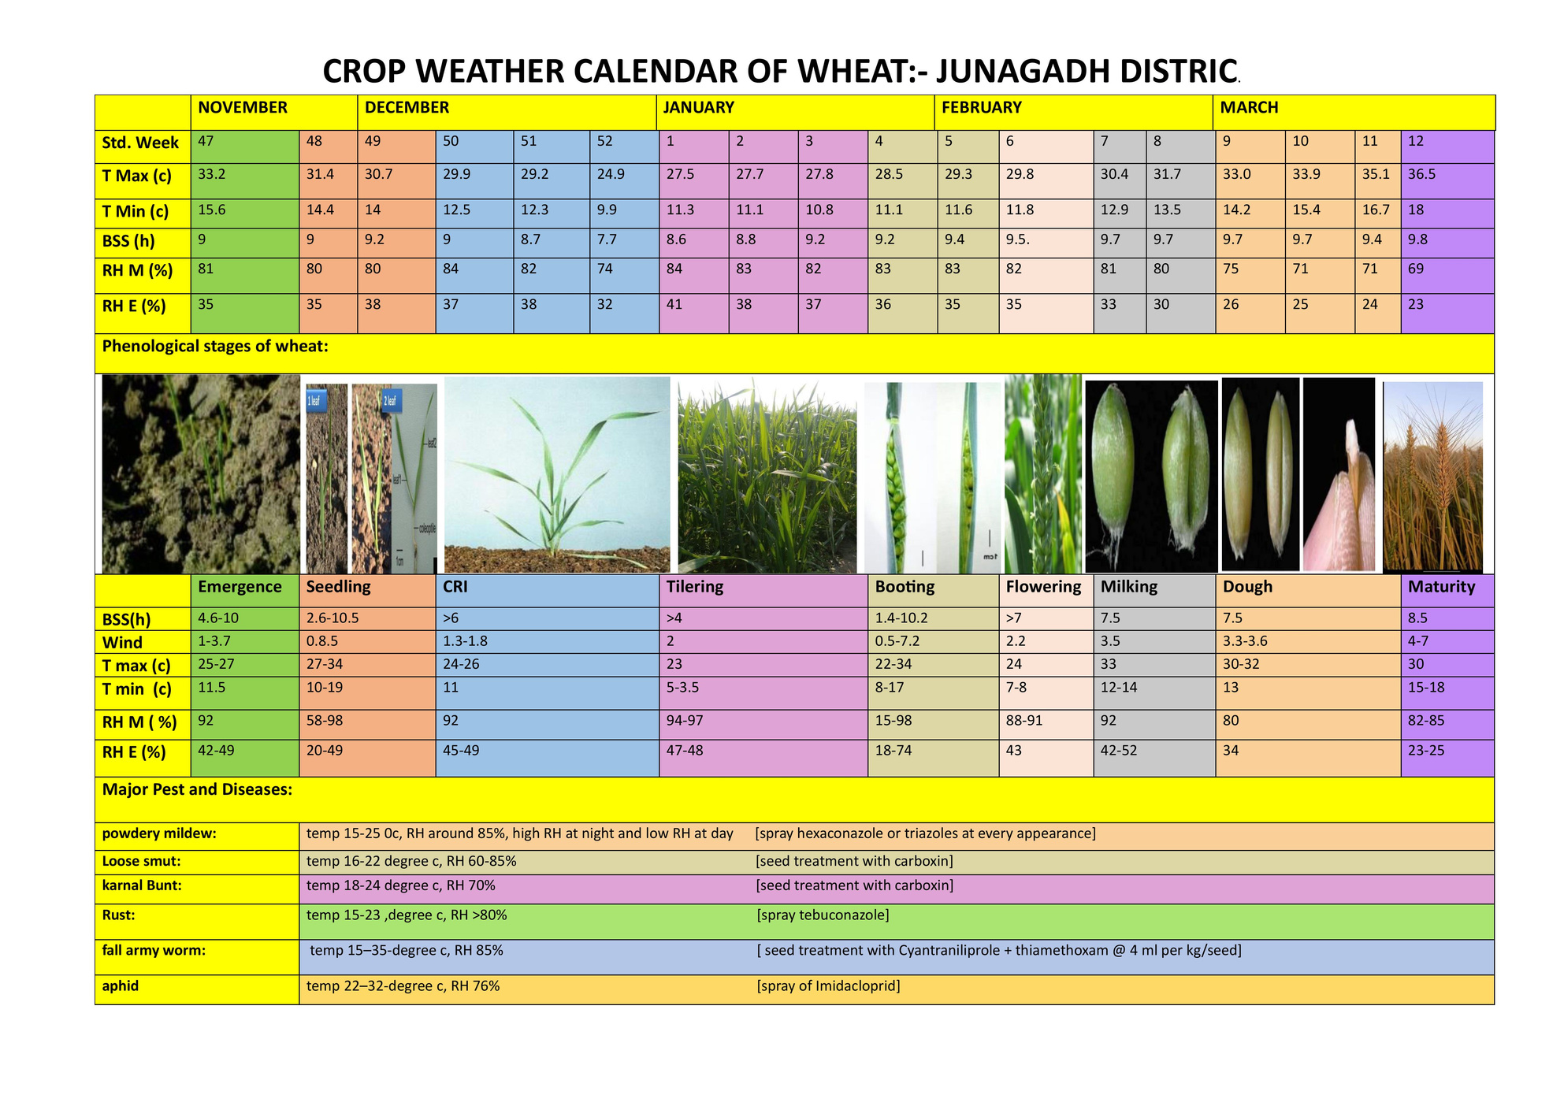
RESULT

Slide 7
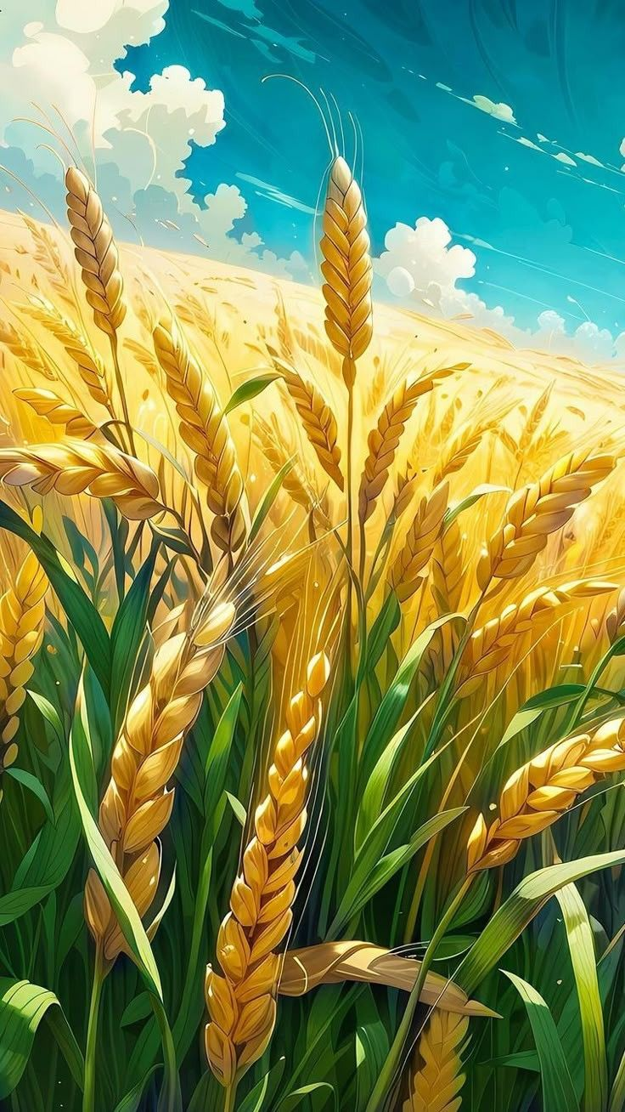
HEAT INDICES
Heat indices are temperature-based measures used to quantify the thermal environment of crops and to relate weather conditions with crop growth and development.
The most common and widely applied is the Growing Degree Days (GDD), which accumulates daily mean temperature above a base threshold to represent thermal time for crop stages.
Others include Heliothermal Units (HTU) combine GDD with actual sunshine hours to capture both heat and radiation effects.
Photothermal Units (PTU) integrate GDD with day length (photoperiod) to reflect the influence of light duration along with temperature
Hydrothermal Units (HyTU) add the role of rainfall or relative humidity to GDD to represent combined heat–moisture effects
Thermal Use Efficiency (TUE) relates biomass or yield to accumulated GDD

Slide 8

GDD
Growing Degree Days (GDD) is a heat index used to measure the thermal time needed for crop development. It is calculated as the average of daily maximum and minimum temperatures minus a base temperature (5°C for wheat).
GDD=((Tmax​+Tmin)/2)​​−Tbase​
If the mean temperature is below the base, GDD is zero for that day. By accumulating daily values, cumulative GDD indicates the heat requirement for each growth stage, making it useful for predicting phenology, comparing varieties, and guiding irrigation, nutrient use, and yield forecasting.

Slide 9
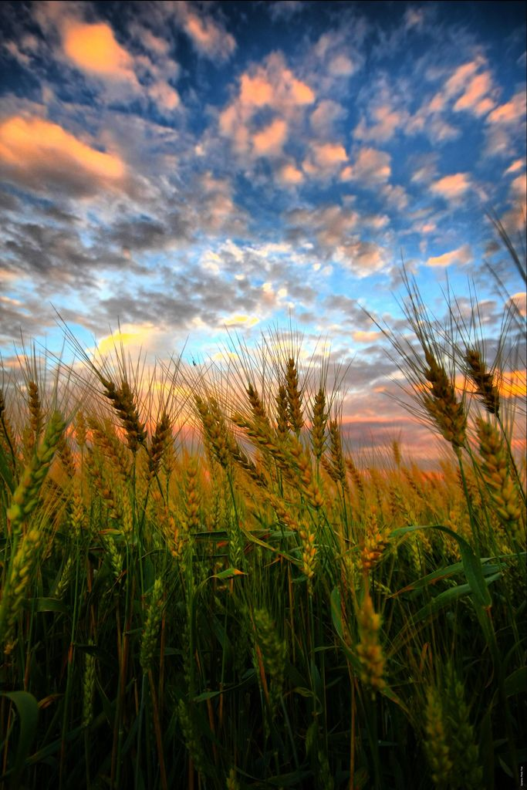
DATA COLLECTION
The study used phenology data of wheat growth stages (2019–2024) and corresponding daily weather data (temperature records) for the same period, covering multiple crop seasons to analyze stage-wise crop development.

Slide 10
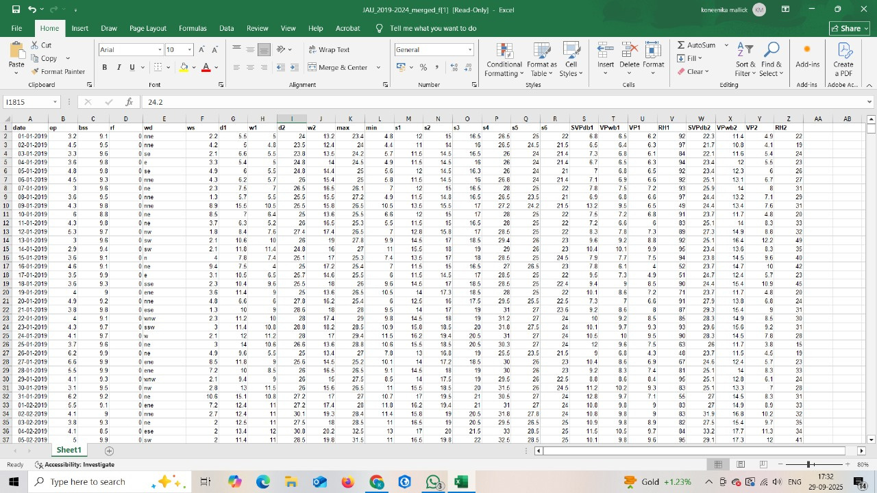
DATA

Slide 11
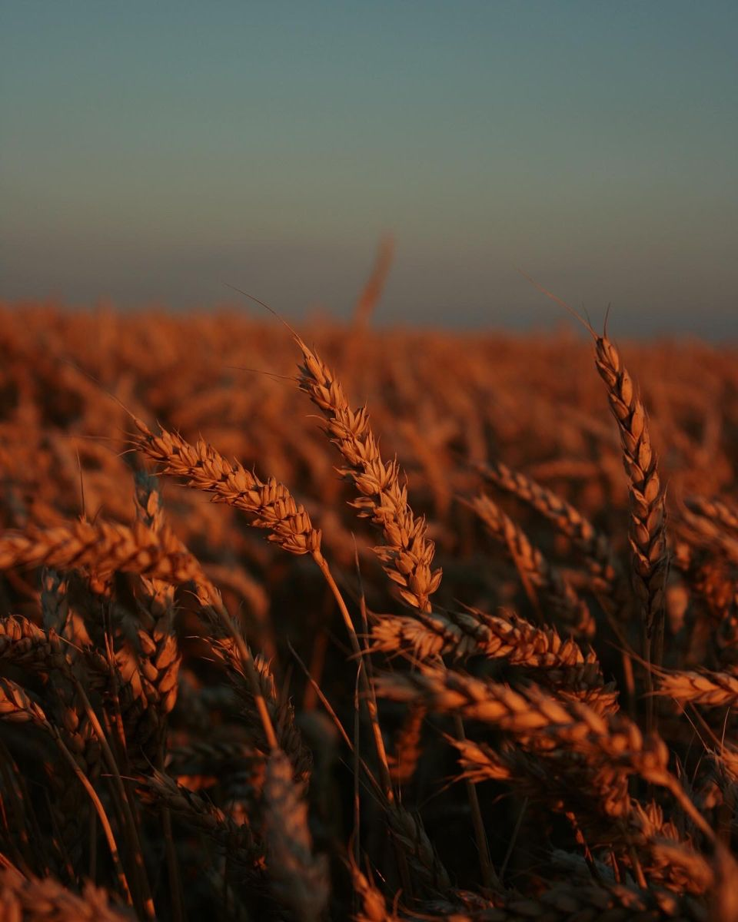
1
Data Preparation
Calculated daily mean temperature and Growing Degree Days (GDD) using max and min temperature data.
Generated cumulative GDD and average temperature up to each stage.
These features (CumGDD, AvgTemp) were chosen as inputs since they capture heat accumulation affecting crop growth.
2
Dataset Splitting
Divided data into two parts:
Training dataset: 2019–2023 seasons (to train models).
Validation dataset: 2023–24 season (to test performance).
This ensures models learn from historical data but are evaluated on unseen, real-world conditions.
METHODOLOGY

Slide 12
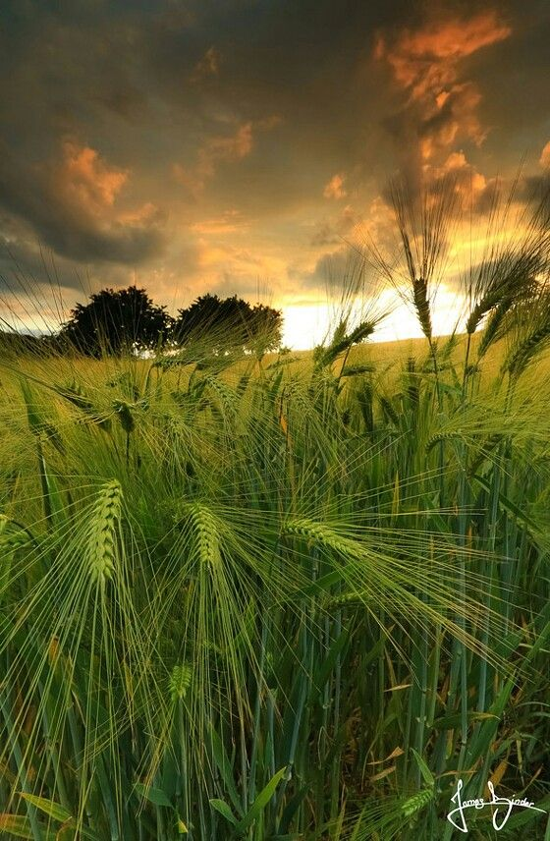
3
Model Development
Implemented four models:
Linear Regression (baseline, simple linear relation).
Random Forest Regressor (ensemble of decision trees for nonlinearity).
Support Vector Machine (SVM) (uses kernel trick for complex relations).
XGBoost (boosting algorithm for high accuracy).
Trained each model with features (CumGDD, AvgTemp) and target (Days from sowing).
4
Model Evaluation
Predictions were compared against actual phenology observations.
Used statistical metrics:
MSE (Mean Squared Error) : penalizes large errors.
RMSE (Root Mean Squared Error) : error in actual days.
MAE (Mean Absolute Error) –:average error in days.
R² (Coefficient of Determination) :proportion of variance explained.
METHODOLOGY

Slide 13
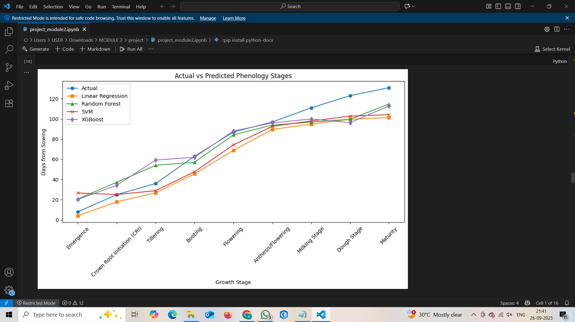
RESULTS

Slide 14
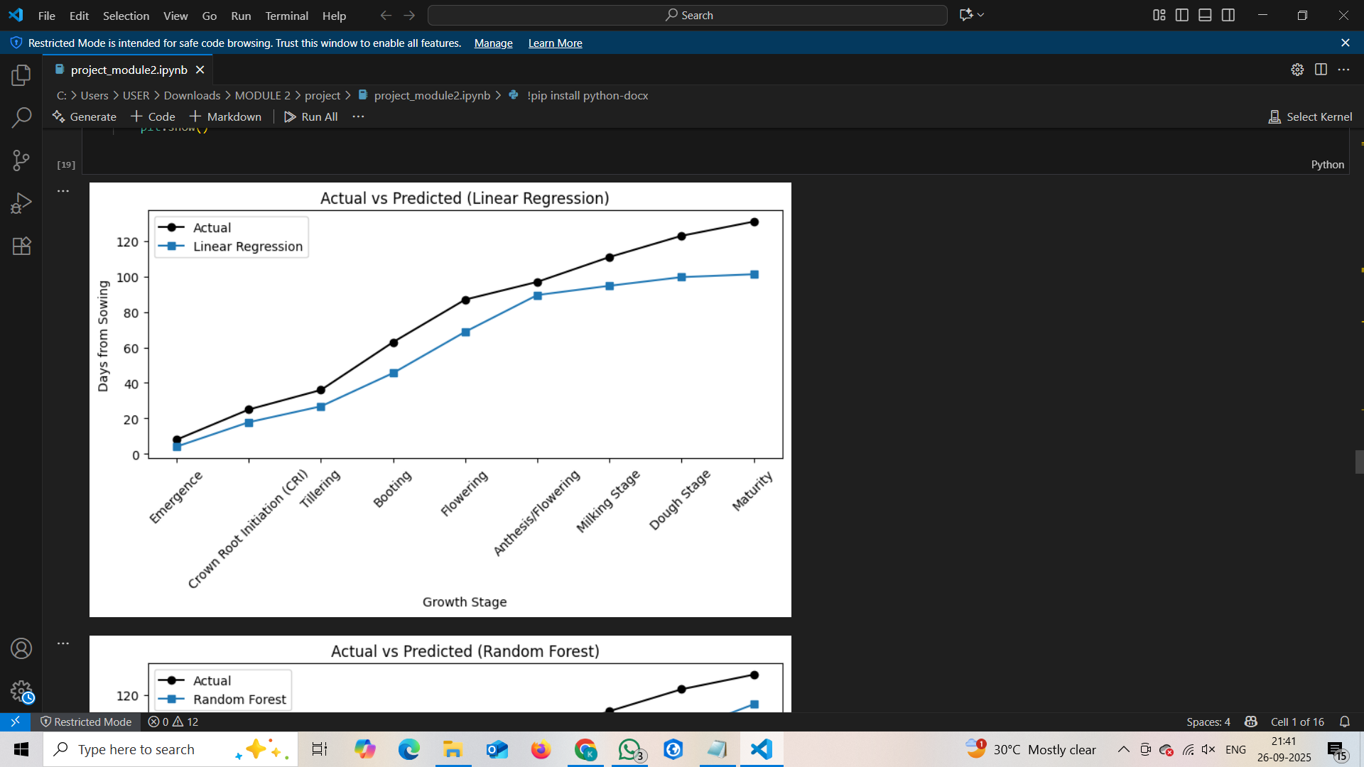
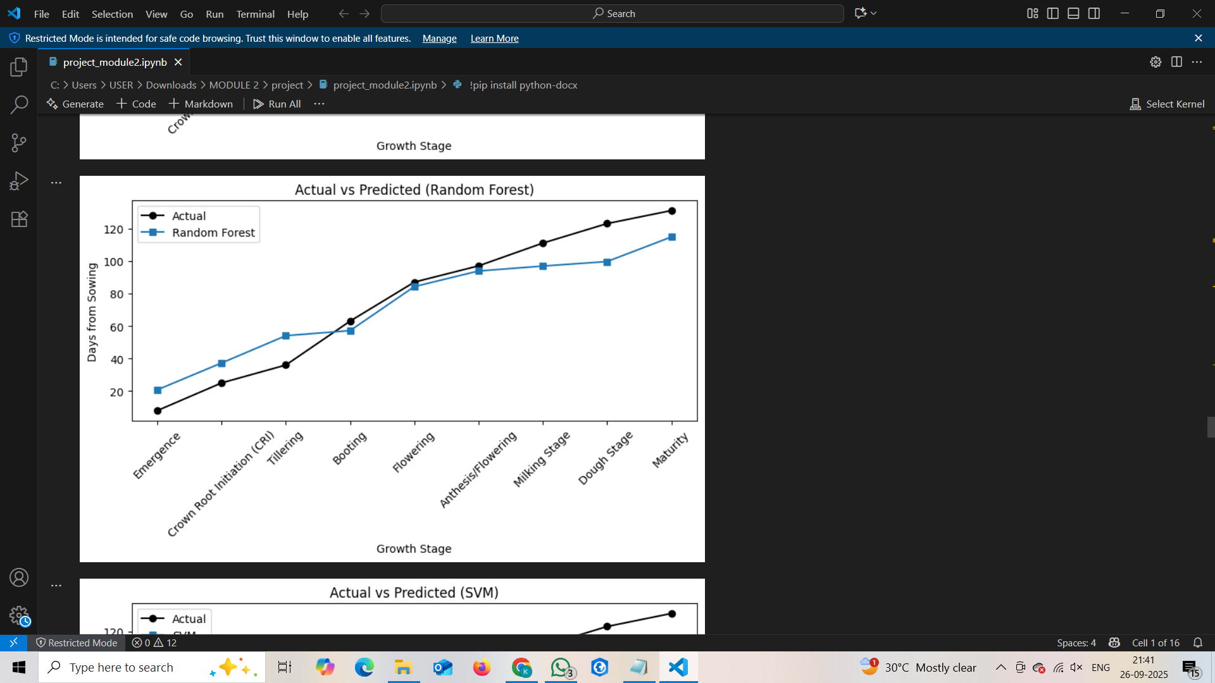
RESULTS

Slide 15
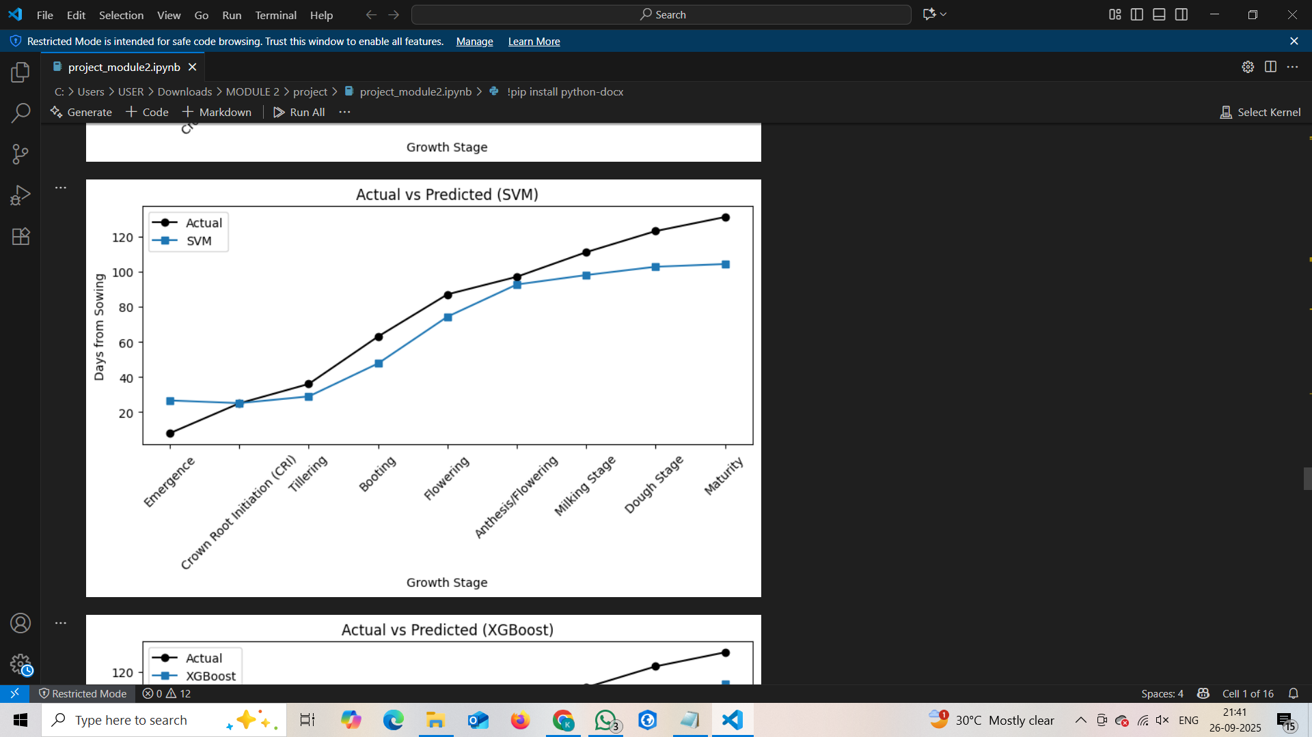
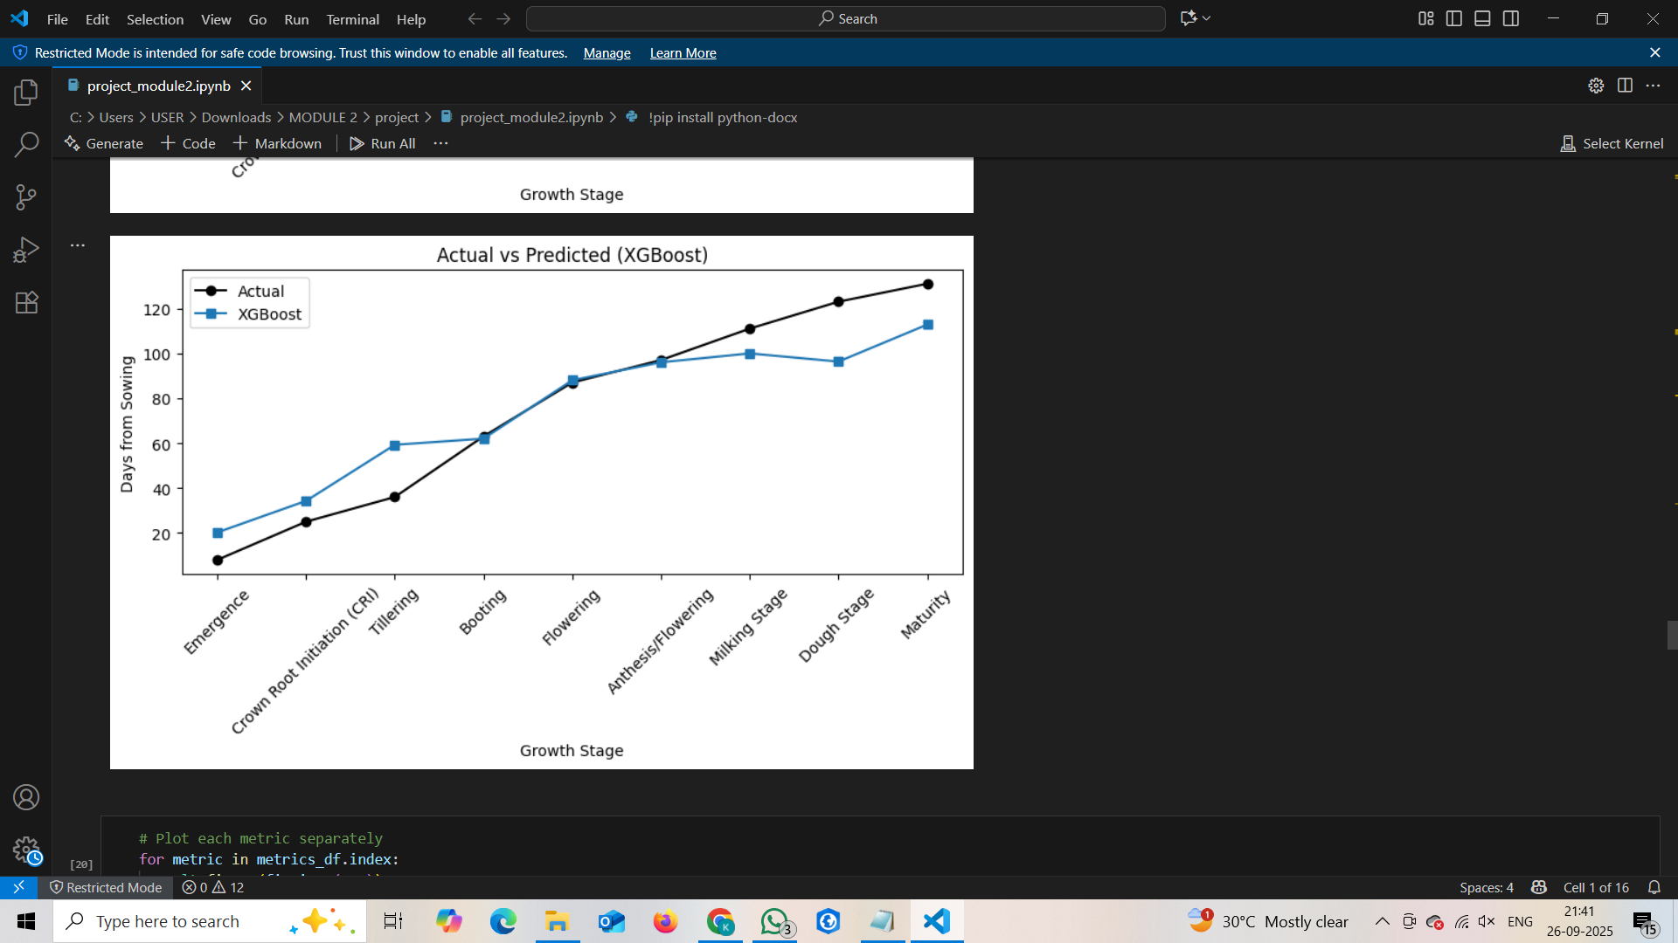
RESULTS

Slide 16
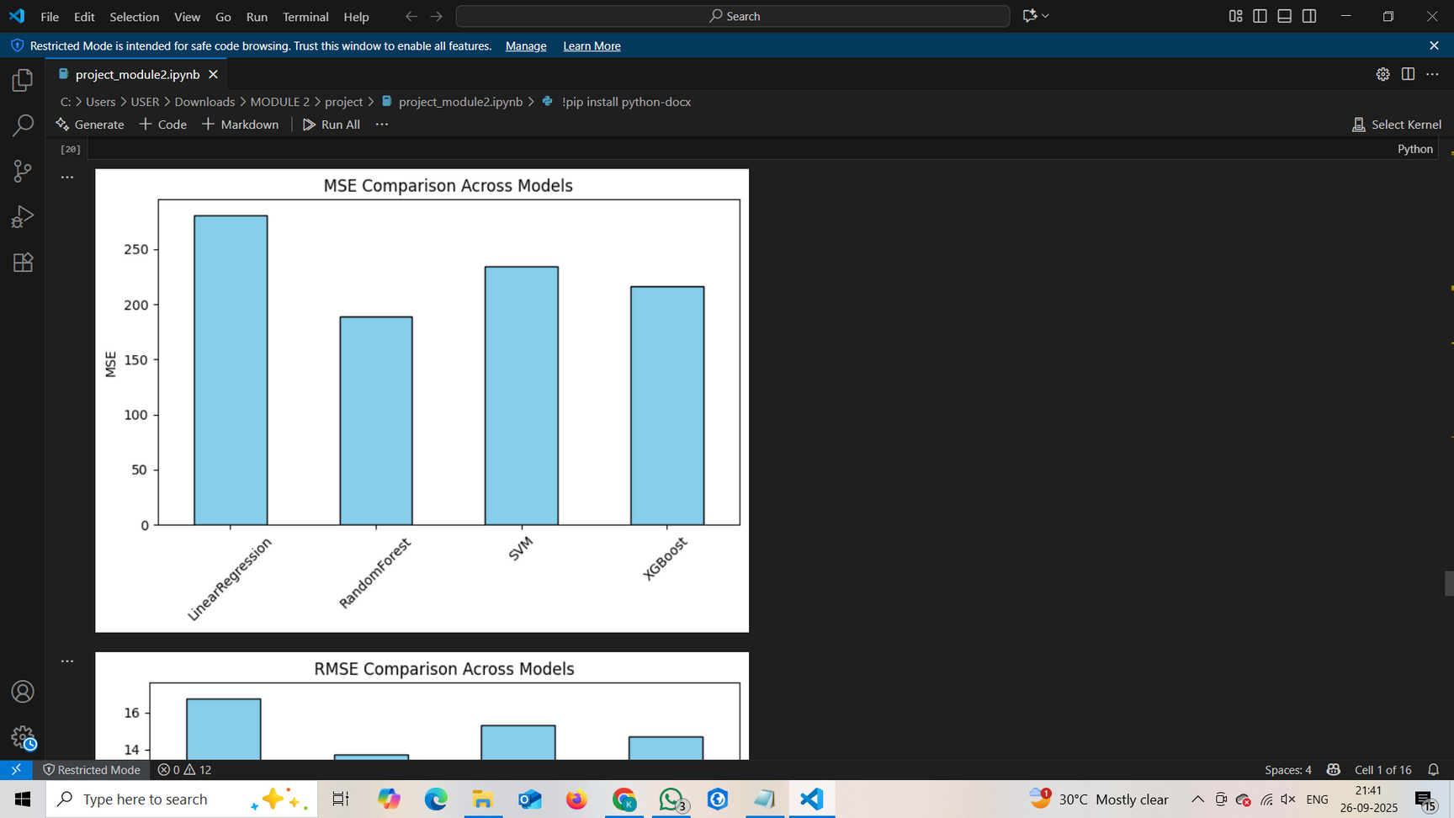
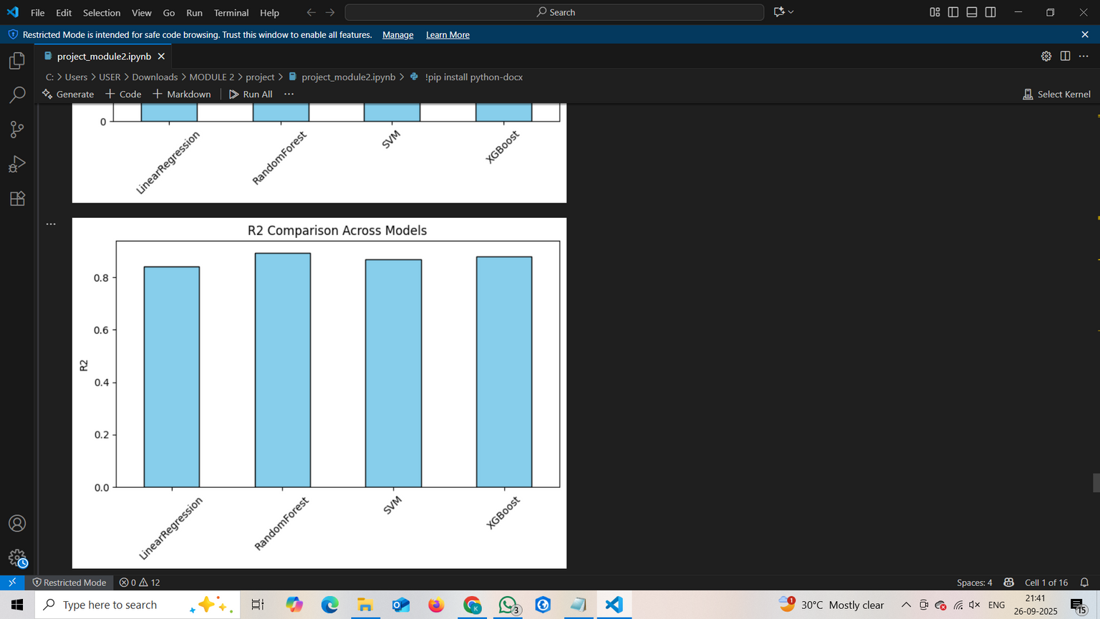
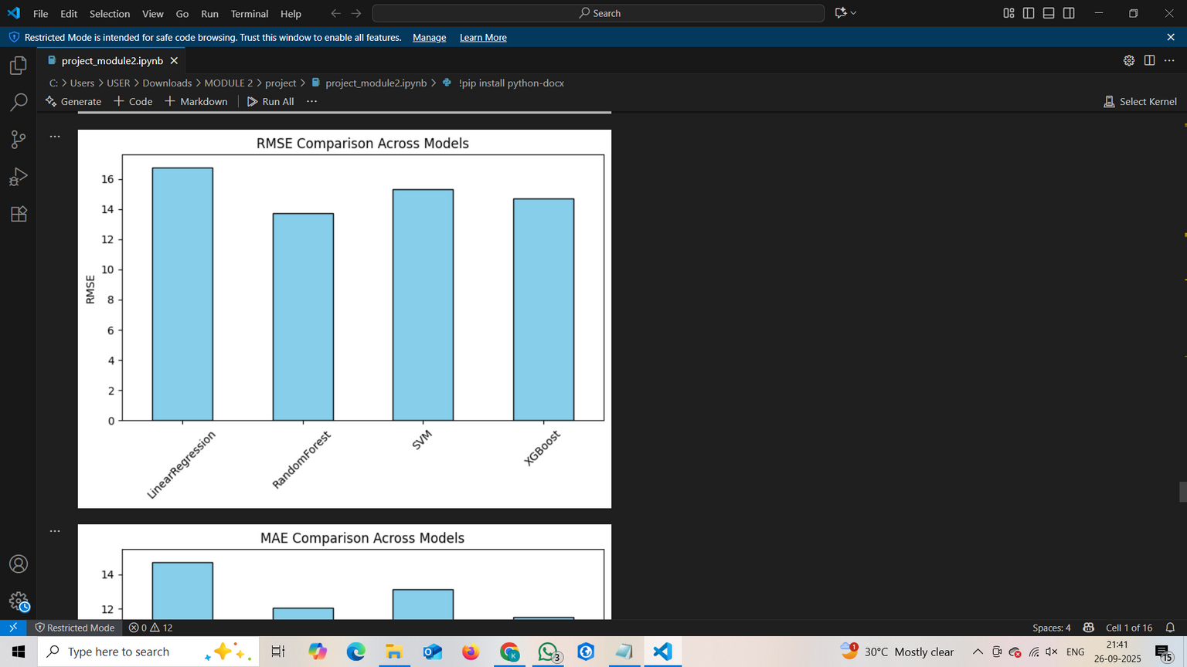
RESULTS

Slide 17
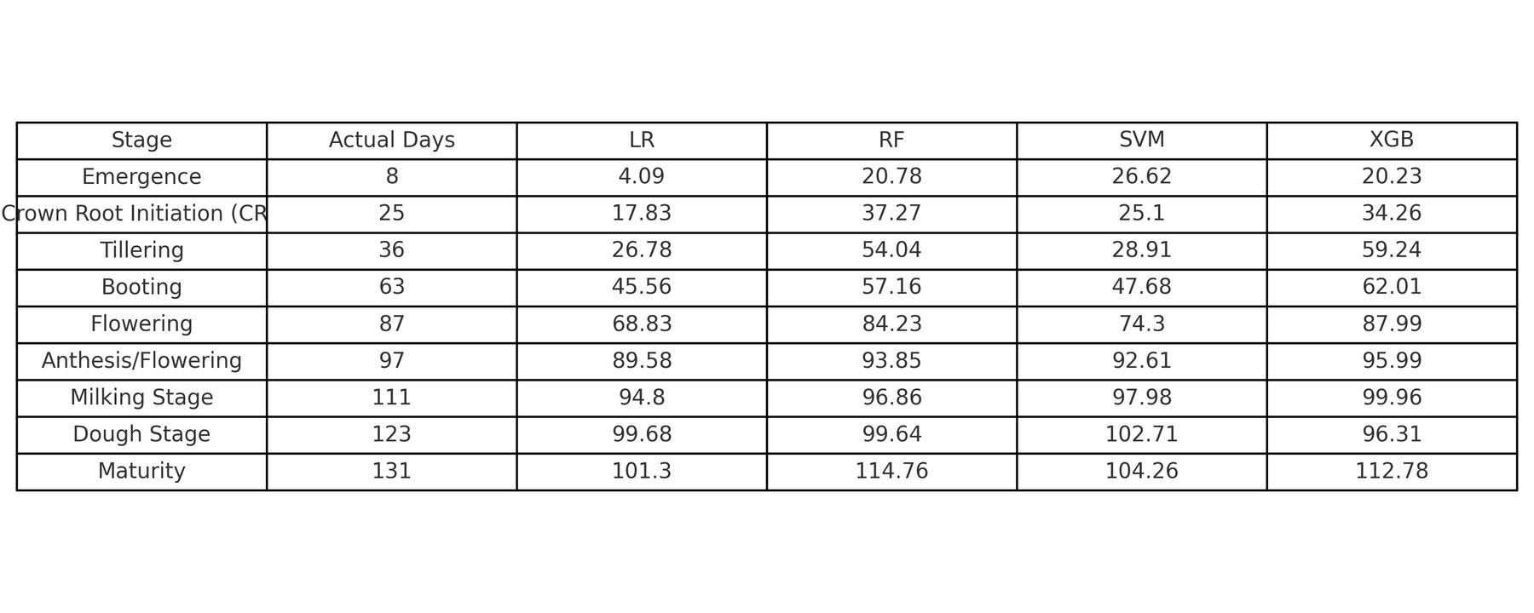
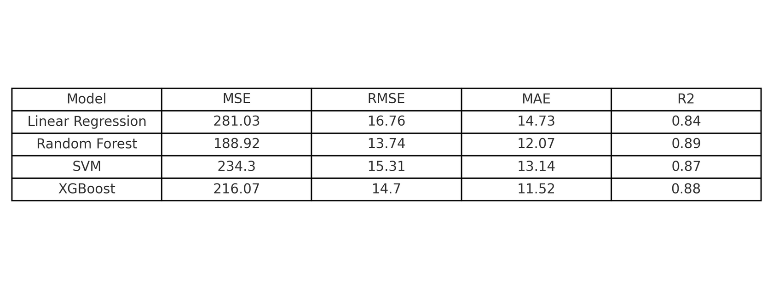
RESULTS
PREDICTION RESULTS
VALIDATION METRICES

Slide 18
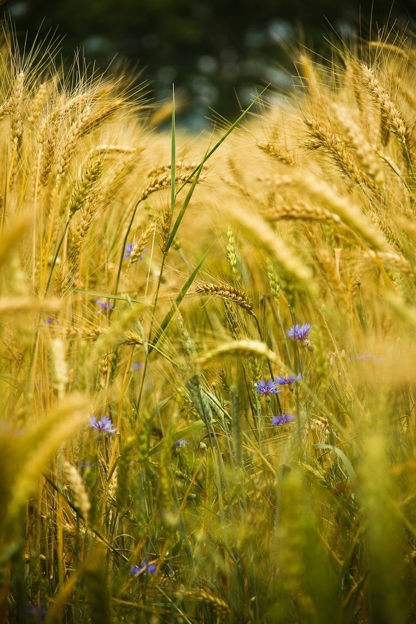
CONCLUSION
The study demonstrated that wheat phenology can be effectively predicted using heat indices (GDD) combined with machine learning models. Among the models tested, Random Forest and XGBoost provided the most accurate predictions, closely matching actual stage durations, while Linear Regression showed underfitting and SVM gave moderate results. This highlights the potential of integrating weather-based indices with ML to develop dynamic crop calendars, which can improve agricultural planning and resource management.

Slide 19
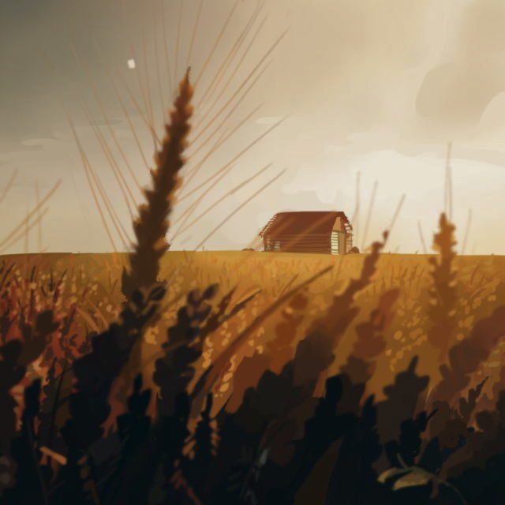
THANK YOU
-

